Slide 1

Scientific Computing with Python
Austin, Texas • July 11-17, 2016
Machine Learning
with
Sebastian Raschka & Andreas Mueller

Slide 2
Links
Tutorial Material on GitHub:
https://github.com/amueller/scipy-2016-sklearn
Contact Info:
Sebastian Raschka
mail@sebastianraschka.com
http://sebastianraschka.com
@rasbt
Andreas Mueller
t3kcit+website@gmail.com
http://amueller.github.io
@amuellerml

Slide 3
Tutorial Setup I
a) Fork the Repository (if you haven’t done so, yet):
b) Sync an older fork:
$ git remote add upstream https://github.com/amueller/scipy-2016-sklearn.git
$ git fetch upstream
$ git checkout master merge upstream/master

Slide 4
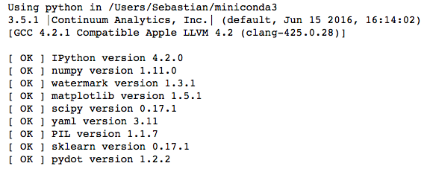
Tutorial Setup II
jupyter notebook check_env.ipynb
python fetch_data.py
~456 MB!!!

Slide 5
Our Agenda
Morning Session: 8:00 AM - 12:00 PM (Room 105)
Afternoon Session: 1:30 PM - 5:30 PM (Room 105)

Slide 6
Morning Session
8:00 AM - 12:00 PM
01 Introduction to machine learning with sample applications
02 Scientific Computing Tools for Python: NumPy, SciPy, and matplotlib
03 Data formats, preparation, and representation
04 Supervised learning: Training and test data
05 Supervised learning: Estimators for classification
06 Supervised learning: Estimators for regression analysis
07 Unsupervised learning: Unsupervised Transformers
08 Unsupervised learning: Clustering
09 The scikit-learn estimator interface
10 Preparing a real-world dataset (titanic)
11 Working with text data via the bag-of-words model
12 Application: SMS spam classification

Slide 7
Afternoon Session
1:30 PM - 5:30 PM
13 Cross-Validation
14 Model complexity and grid search for adjusting hyperparameters
15 Scikit-learn Pipelines
16 Supervised learning: Performance metrics for classification
17 Supervised learning: Linear Models
18 Supervised learning: Support Vector Machines
19 Supervised learning: Decision trees and random forests, ensemble methods
20 Supervised learning: feature selection
21 Unsupervised learning: Hierarchical and density-based clustering algorithms
22 Unsupervised learning: Non-linear dimensionality reduction
23 Supervised learning: Out-of-core learning

Slide 8
Morning Session
8:00 AM - 12:00 PM
01 Introduction to machine learning with sample applications
02 Scientific Computing Tools for Python: NumPy, SciPy, and matplotlib
03 Data formats, preparation, and representation
04 Supervised learning: Training and test data
05 Supervised learning: Estimators for classification
06 Supervised learning: Estimators for regression analysis
07 Unsupervised learning: Unsupervised Transformers
08 Unsupervised learning: Clustering
09 The scikit-learn estimator interface
10 Preparing a real-world dataset (titanic)
11 Working with text data via the bag-of-words model
12 Application: SMS spam classification
s

Slide 9
What is Machine Learning?
Inputs (observations)
“Traditional” programming
Programmer
Program
Computer
Outputs
Machine Learning is the field of study that gives computers the ability to learn without being explicitly programmed.
-- Arthur Samuel (1959)
Inputs (observations)
Machine Learning
Computer
Program
Outputs

Slide 10

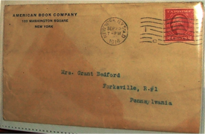

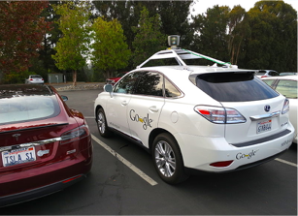
Examples of Machine Learning
https://flic.kr/p/5BLW6G [CC BY 2.0]
http://commons.wikimedia.org/wiki/File:American_book_company_1916._letter_envelope-2.JPG#filelinks [public domain]
http://commons.wikimedia.org/wiki/File:Netflix_logo.svg [public domain]
And many, many more …
By Steve Jurvetson [CC BY 2.0]

Slide 11
3 Types of Learning
Supervised
Unsupervised
Reinforcement
Learning from labeled data
E.g., Spam classification
Discover structure in unlabeled data
E.g., Document clustering
Learning by “doing” with delayed reward
E.g., Chess computer

Slide 12
Supervised Learning
Supervised
Classification
Regression
y=12.5
?
?
x=0.8

Slide 13
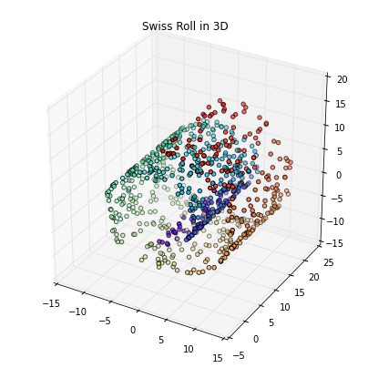
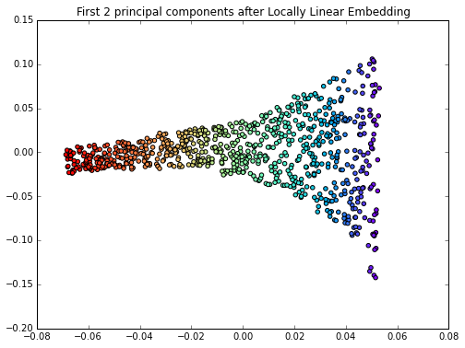
Unsupervised Learning
Unsupervised
Clustering
Compression

Slide 14
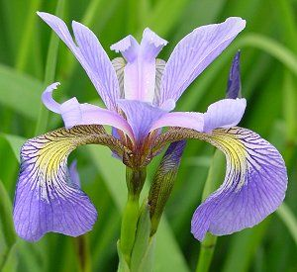
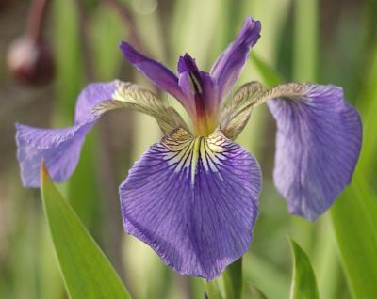
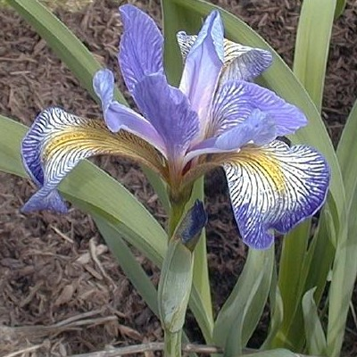
Flower Classification
Iris-Setosa
Iris-Versicolor
Iris-Setosa

Slide 15
Data Representation

Slide 16
Morning Session
8:00 AM - 12:00 PM
01 Introduction to machine learning with sample applications
02 Scientific Computing Tools for Python: NumPy, SciPy, and matplotlib
03 Data formats, preparation, and representation
04 Supervised learning: Training and test data
05 Supervised learning: Estimators for classification
06 Supervised learning: Estimators for regression analysis
07 Unsupervised learning: Unsupervised Transformers
08 Unsupervised learning: Clustering
09 The scikit-learn estimator interface
10 Preparing a real-world dataset (titanic)
11 Working with text data via the bag-of-words model
12 Application: SMS spam classification
s

Slide 17
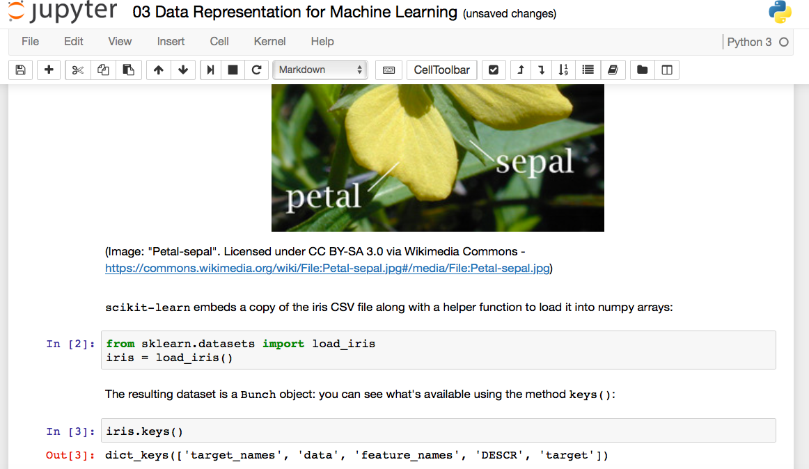
Jupyter Notebooks

Slide 18
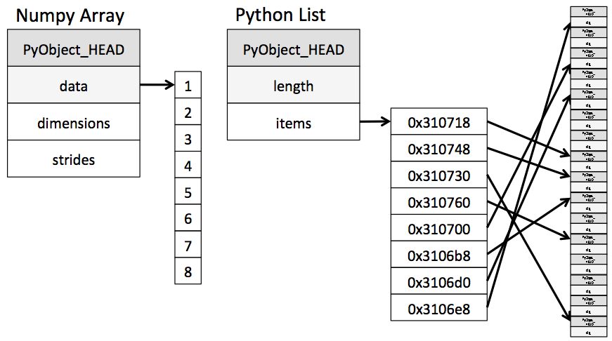
NumPy Arrays
build around a C array with pointers to a contiguous data buffer of values
Linear algebra functions
Fancy indexing
…
>>> import numpy
>>> ary = numpy.array([7, 8, 9, 10, 11])
>>> ary[[2, 4]]
array([ 9, 11])
>>> lst = list([7, 8, 9, 10, 11])
>>> lst[2, 4]]
>>> lst[[2, 4]]
Traceback (most recent call last):
File "<stdin>", line 1, in <module>
TypeError: list indices must be
integers or slices, not list
Image source: “Why Python is Slow: Looking Under the Hood” by Jake VanderPlas
http://jakevdp.github.io/blog/2014/05/09/why-python-is-slow/

Slide 19
Scipy Sparse Matrices
List of Lists (LIL) example
>>> from scipy import sparse
>>> mtx = sparse.lil_matrix([[0, 1, 2, 0],
... [3, 0, 1, 0],
... [1, 0, 0, 1]])
>>> print(mtx)
(0, 1) 1
(0, 2) 2
(1, 0) 3
(1, 2) 1
(2, 0) 1
(2, 3) 1
>>> print(mtx.toarray())
[[0 1 2 0]
[3 0 1 0]
[1 0 0 1]]

Slide 20
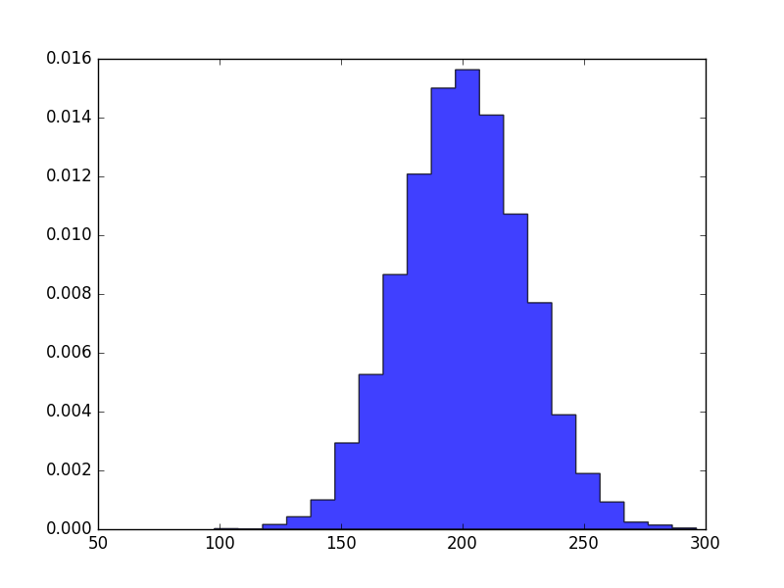
Matplotlib
>>> import matplotlib.pyplot as plt
>>> import numpy as np
>>>
>>> mu, sigma = 200, 25
>>> x = mu + sigma*np.random.randn(10000)
>>> plt.hist(x, 20, normed=1,
... histtype='stepfilled',
... facecolor='b',
... alpha=0.75)
>>> plt.show()

Slide 21
Morning Session
8:00 AM - 12:00 PM
01 Introduction to machine learning with sample applications
02 Scientific Computing Tools for Python: NumPy, SciPy, and matplotlib
03 Data formats, preparation, and representation
04 Supervised learning: Training and test data
05 Supervised learning: Estimators for classification
06 Supervised learning: Estimators for regression analysis
07 Unsupervised learning: Unsupervised Transformers
08 Unsupervised learning: Clustering
09 The scikit-learn estimator interface
10 Preparing a real-world dataset (titanic)
11 Working with text data via the bag-of-words model
12 Application: SMS spam classification
s

Slide 22
Iris
Iris-Setosa
Iris-Versicolor
Iris-Setosa

Slide 23
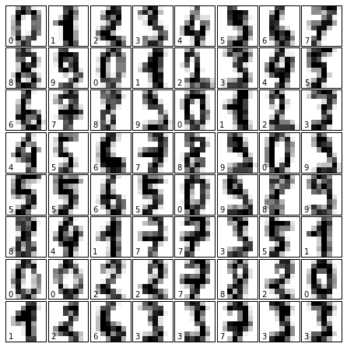
Digits

Slide 24
Generating Synthetic Data
from sklearn.datasets import make_…

Slide 25
Morning Session
8:00 AM - 12:00 PM
01 Introduction to machine learning with sample applications
02 Scientific Computing Tools for Python: NumPy, SciPy, and matplotlib
03 Data formats, preparation, and representation
04 Supervised learning: Training and test data
05 Supervised learning: Estimators for classification
06 Supervised learning: Estimators for regression analysis
07 Unsupervised learning: Unsupervised Transformers
08 Unsupervised learning: Clustering
09 The scikit-learn estimator interface
10 Preparing a real-world dataset (titanic)
11 Working with text data via the bag-of-words model
12 Application: SMS spam classification
A

Slide 26
Training & Test Data
All Data
Training Data
Test Data
Typically:
75% : 25%
2/3 : 1/3

Slide 27
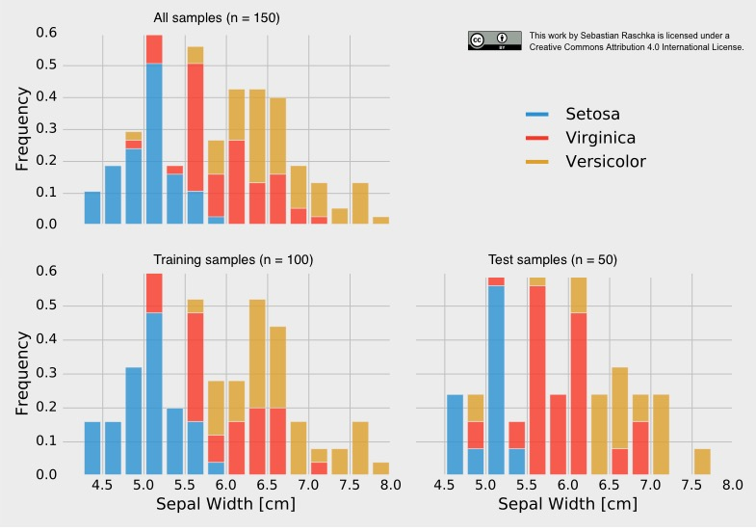
Stratification
Non-stratified split:
training set → 38 x Setosa, 28 x Versicolor, 34 x Virginica
test set → 12 x Setosa, 22 x Versicolor, 16 x Virginica

Slide 28
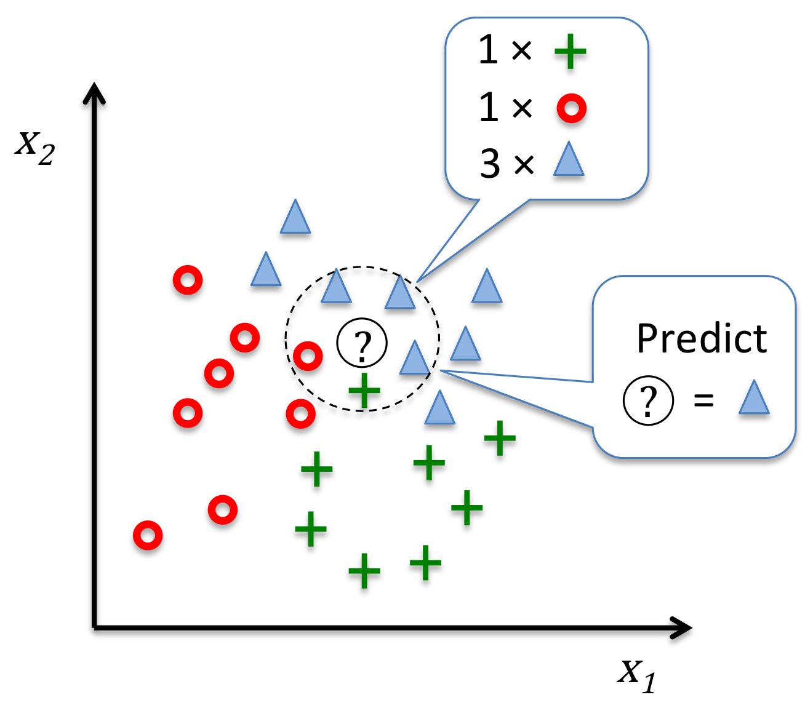
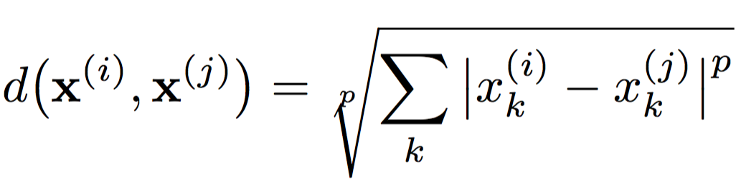
K-Nearest Neighbors
k=5
Image source: https://github.com/rasbt/python-machine-learning-book/blob/master/code/ch03/images/03_20.png

Slide 29
Morning Session
8:00 AM - 12:00 PM
01 Introduction to machine learning with sample applications
02 Scientific Computing Tools for Python: NumPy, SciPy, and matplotlib
03 Data formats, preparation, and representation
04 Supervised learning: Training and test data
05 Supervised learning: Estimators for classification
06 Supervised learning: Estimators for regression analysis
07 Unsupervised learning: Unsupervised Transformers
08 Unsupervised learning: Clustering
09 The scikit-learn estimator interface
10 Preparing a real-world dataset (titanic)
11 Working with text data via the bag-of-words model
12 Application: SMS spam classification
A

Slide 30
Supervised Workflow
TRAINING
GENERALIZATION
Fit model on all data after evaluation

Slide 31
Supervised Workflow
estimator.fit(X_train, y_train)
TRAINING
estimator.predict(X_test)
GENERALIZATION
estimator.score(X_test, y_test)

Slide 32
Morning Session
8:00 AM - 12:00 PM
01 Introduction to machine learning with sample applications
02 Scientific Computing Tools for Python: NumPy, SciPy, and matplotlib
03 Data formats, preparation, and representation
04 Supervised learning: Training and test data
05 Supervised learning: Estimators for classification
06 Supervised learning: Estimators for regression analysis
07 Unsupervised learning: Unsupervised Transformers
08 Unsupervised learning: Clustering
09 The scikit-learn estimator interface
10 Preparing a real-world dataset (titanic)
11 Working with text data via the bag-of-words model
12 Application: SMS spam classification
A

Slide 33
Linear Regression
y =coef_[0]*X[0] + intercept_
y (target variable)
X[0] (feature variable)

Slide 34
Morning Session
8:00 AM - 12:00 PM
01 Introduction to machine learning with sample applications
02 Scientific Computing Tools for Python: NumPy, SciPy, and matplotlib
03 Data formats, preparation, and representation
04 Supervised learning: Training and test data
05 Supervised learning: Estimators for classification
06 Supervised learning: Estimators for regression analysis
07 Unsupervised learning: Unsupervised Transformers
08 Unsupervised learning: Clustering
09 The scikit-learn estimator interface
10 Preparing a real-world dataset (titanic)
11 Working with text data via the bag-of-words model
12 Application: SMS spam classification
S

Slide 35
Unsupervised Transformers
transformer.fit(X_train)
X_train_transf = transformer.transform(X_train)
X_test_transf = transformer.transform(X_test)

Slide 36
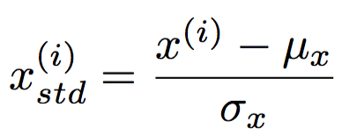
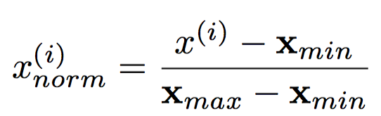
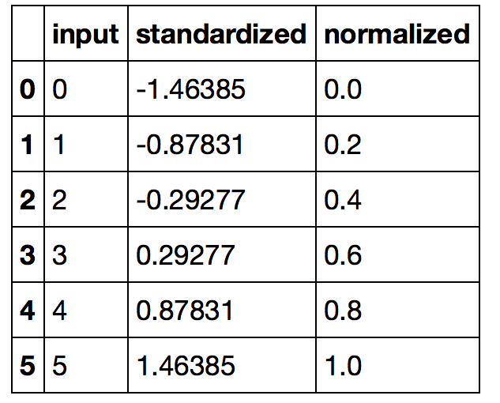
Feature Scaling
min-max scaling
(“normalization”)
standardization

Slide 37
Principal Component Analysis
PC1
PC2
x₂
x₁

Slide 38
PCA for Dimensionality Reduction

Slide 39
Morning Session
8:00 AM - 12:00 PM
01 Introduction to machine learning with sample applications
02 Scientific Computing Tools for Python: NumPy, SciPy, and matplotlib
03 Data formats, preparation, and representation
04 Supervised learning: Training and test data
05 Supervised learning: Estimators for classification
06 Supervised learning: Estimators for regression analysis
07 Unsupervised learning: Unsupervised Transformers
08 Unsupervised learning: Clustering
09 The scikit-learn estimator interface
10 Preparing a real-world dataset (titanic)
11 Working with text data via the bag-of-words model
12 Application: SMS spam classification
S

Slide 40
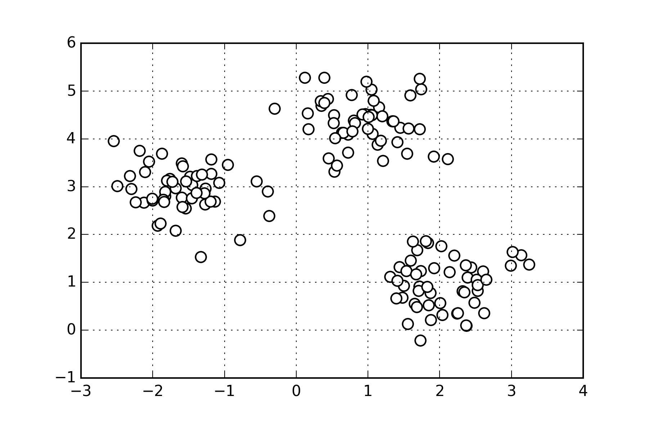
K-means Clustering

Slide 41
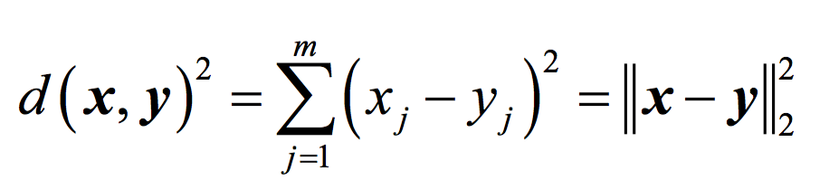
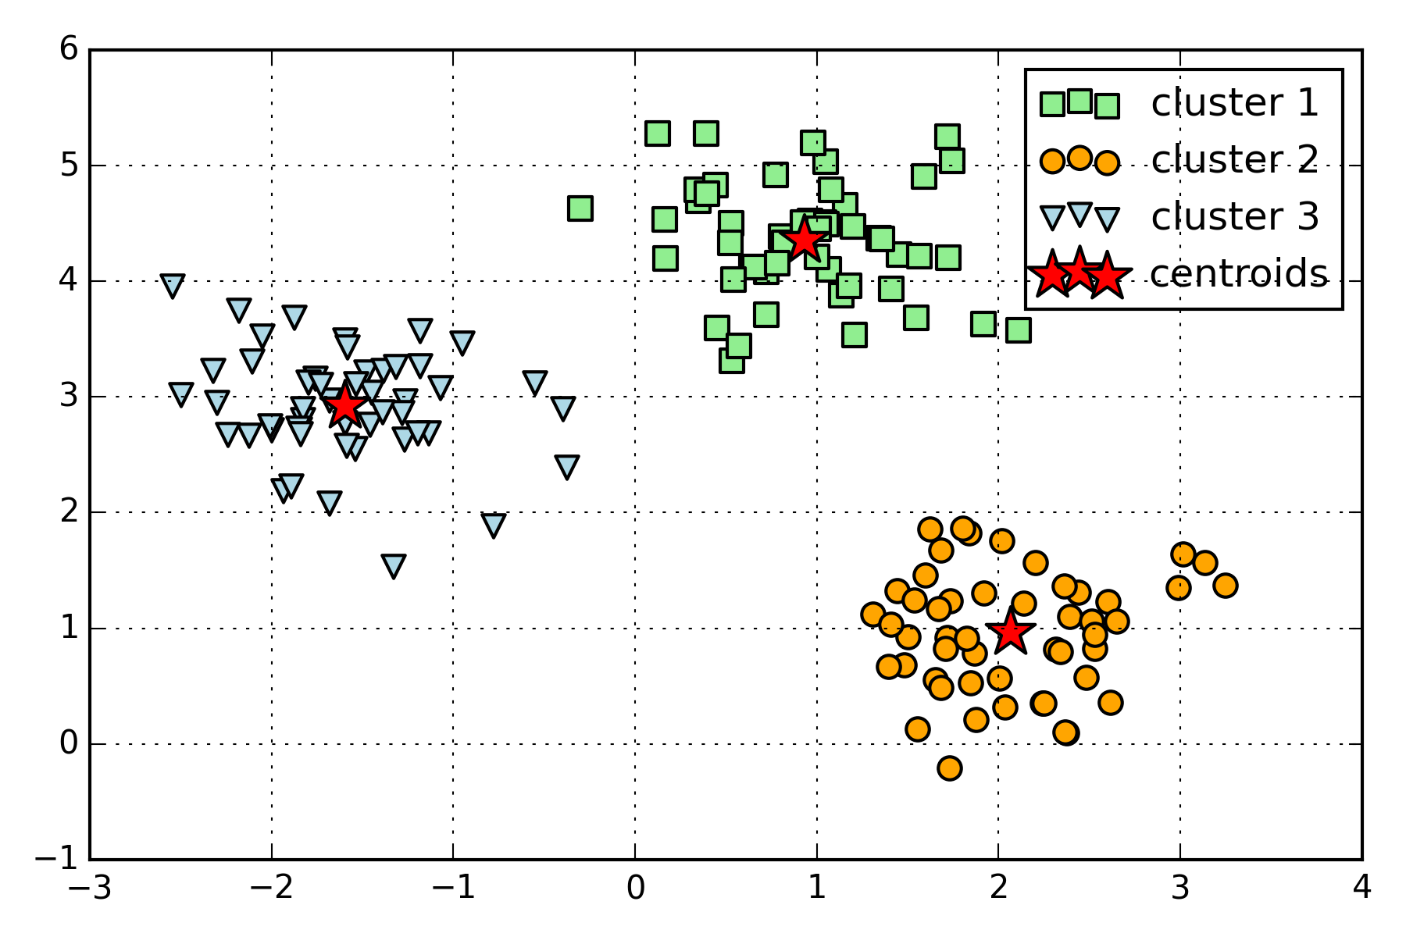
K-means Clustering

Slide 42
Morning Session
8:00 AM - 12:00 PM
01 Introduction to machine learning with sample applications
02 Scientific Computing Tools for Python: NumPy, SciPy, and matplotlib
03 Data formats, preparation, and representation
04 Supervised learning: Training and test data
05 Supervised learning: Estimators for classification
06 Supervised learning: Estimators for regression analysis
07 Unsupervised learning: Unsupervised Transformers
08 Unsupervised learning: Clustering
09 The scikit-learn estimator interface
10 Preparing a real-world dataset (titanic)
11 Working with text data via the bag-of-words model
12 Application: SMS spam classification
A

Slide 43
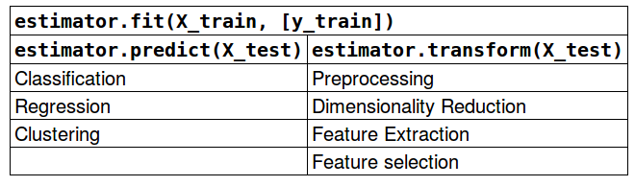
Scikit-learn API

Slide 44
Morning Session
8:00 AM - 12:00 PM
01 Introduction to machine learning with sample applications
02 Scientific Computing Tools for Python: NumPy, SciPy, and matplotlib
03 Data formats, preparation, and representation
04 Supervised learning: Training and test data
05 Supervised learning: Estimators for classification
06 Supervised learning: Estimators for regression analysis
07 Unsupervised learning: Unsupervised Transformers
08 Unsupervised learning: Clustering
09 The scikit-learn estimator interface
10 Preparing a real-world dataset (titanic)
11 Working with text data via the bag-of-words model
12 Application: SMS spam classification
A

Slide 45
Continuous & Categorical Features
Continuous
Categorical
e.g., sepal width in cm
[3.4, 4.7 …]
Nominal
Ordinal
e.g., colors
[red, green, blue, …]
e.g., ratings
[satisfied, neutral, unsatisfied]

Slide 46
Case Study - Titanic Survival

Slide 47
Morning Session
8:00 AM - 12:00 PM
01 Introduction to machine learning with sample applications
02 Scientific Computing Tools for Python: NumPy, SciPy, and matplotlib
03 Data formats, preparation, and representation
04 Supervised learning: Training and test data
05 Supervised learning: Estimators for classification
06 Supervised learning: Estimators for regression analysis
07 Unsupervised learning: Unsupervised Transformers
08 Unsupervised learning: Clustering
09 The scikit-learn estimator interface
10 Preparing a real-world dataset (titanic)
11 Working with text data via the bag-of-words model
12 Application: SMS spam classification
A

Slide 48
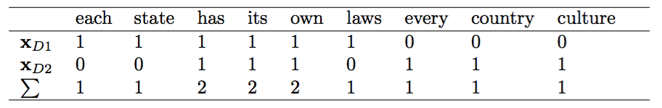
Bag of Words
• D1: ”Each state has its own laws.” • D2: ”Every country has its own culture.”
V ={each:1, state:1, has:2, its:2, own:2,
laws: 1, every: 1, country: 1, culture: 1}

Slide 49
Morning Session
8:00 AM - 12:00 PM
01 Introduction to machine learning with sample applications
02 Scientific Computing Tools for Python: NumPy, SciPy, and matplotlib
03 Data formats, preparation, and representation
04 Supervised learning: Training and test data
05 Supervised learning: Estimators for classification
06 Supervised learning: Estimators for regression analysis
07 Unsupervised learning: Unsupervised Transformers
08 Unsupervised learning: Clustering
09 The scikit-learn estimator interface
10 Preparing a real-world dataset (titanic)
11 Working with text data via the bag-of-words model
12 Application: SMS spam classification
A

Slide 50
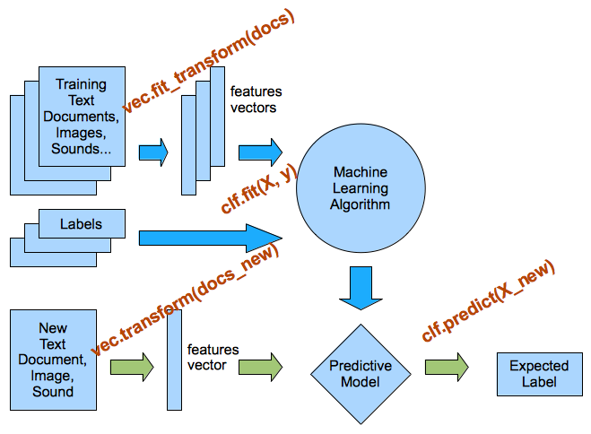
Preprocessing & Classification Overview

Slide 51
Afternoon Session
1:30 PM - 5:30 PM
13 Cross-Validation
14 Model complexity and grid search for adjusting hyperparameters
15 Scikit-learn Pipelines
16 Supervised learning: Performance metrics for classification
17 Supervised learning: Linear Models
18 Supervised learning: Support Vector Machines
19 Supervised learning: Decision trees and random forests, ensemble methods
20 Supervised learning: Feature selection
21 Unsupervised learning: Hierarchical and density-based clustering algorithms
22 Unsupervised learning: Non-linear dimensionality reduction
23 Supervised learning: Out-of-core learning
S

Slide 52
Holdout Evaluation I

Slide 53
Holdout Evaluation II

Slide 54
Holdout Validation I

Slide 55
Holdout Validation II

Slide 56
Holdout Validation III

Slide 57
K-fold Cross-Validation

Slide 58
K-fold Cross-Validation Pipeline I

Slide 59
K-fold Cross-Validation Pipeline II

Slide 60
Nested CV

Slide 61
Afternoon Session
1:30 PM - 5:30 PM
13 Cross-Validation
14 Model complexity and grid search for adjusting hyperparameters
15 Scikit-learn Pipelines
16 Supervised learning: Performance metrics for classification
17 Supervised learning: Linear Models
18 Supervised learning: Support Vector Machines
19 Supervised learning: Decision trees and random forests, ensemble methods
20 Supervised learning: Feature selection
21 Unsupervised learning: Hierarchical and density-based clustering algorithms
22 Unsupervised learning: Non-linear dimensionality reduction
23 Supervised learning: Out-of-core learning
S

Slide 62
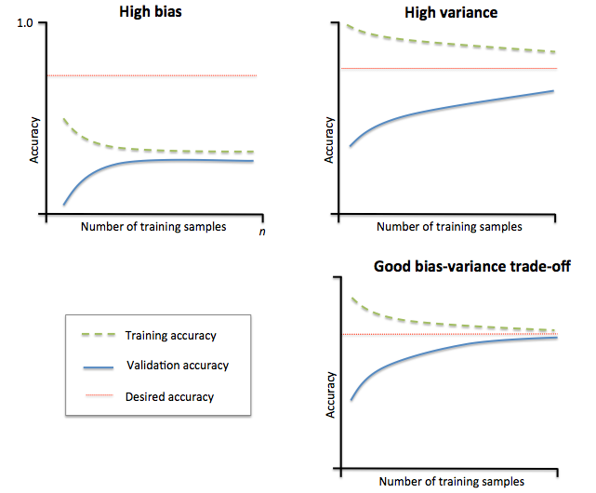
Learning Curves
Image source: https://github.com/rasbt/python-machine-learning-book/blob/master/code/ch06/images/06_04.png

Slide 63
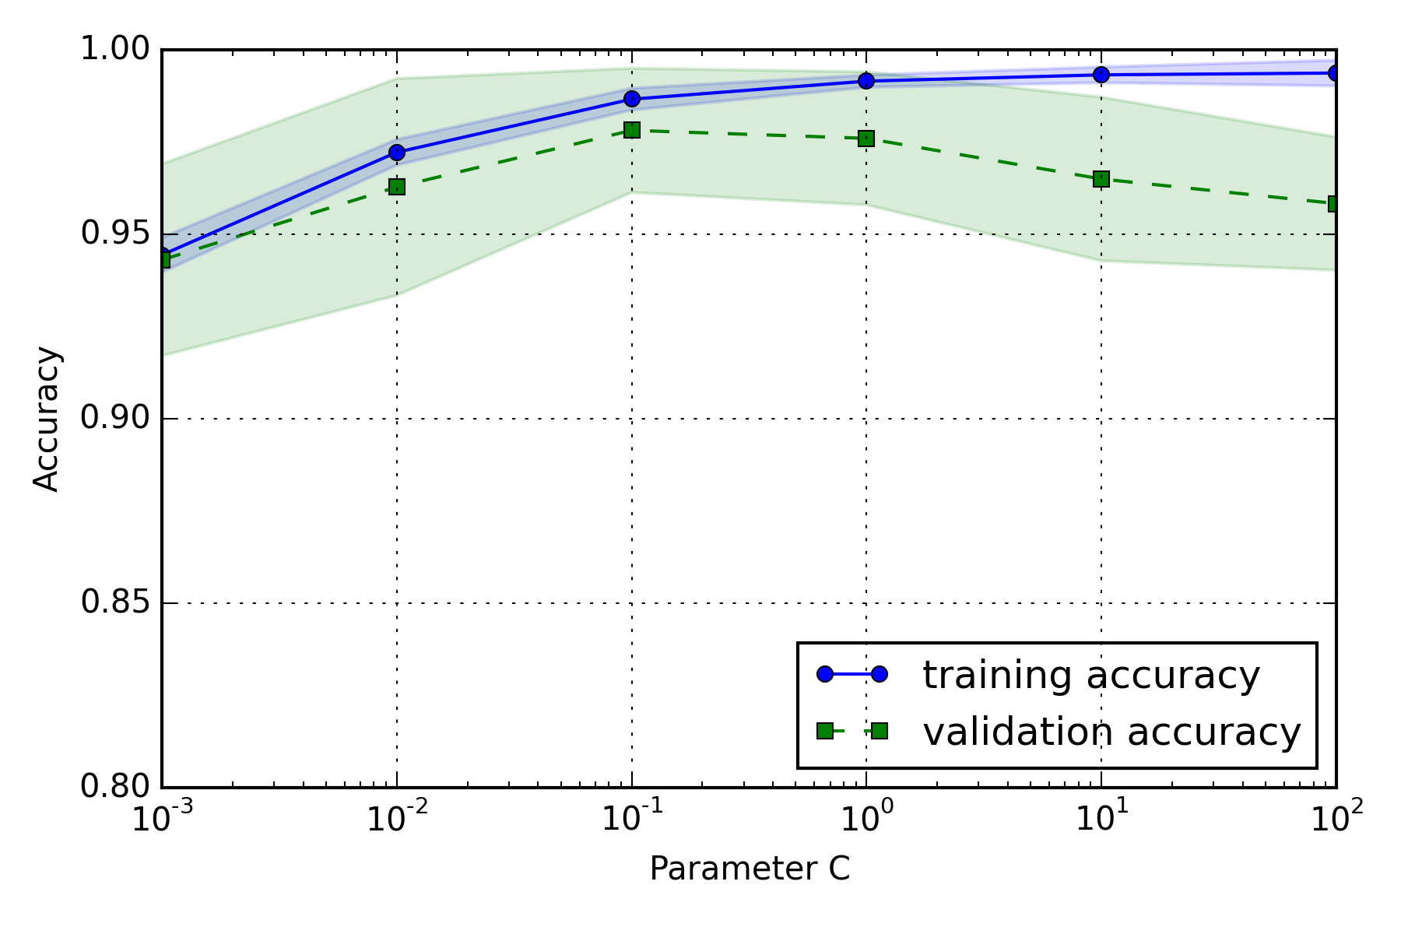
Model Complexity

Slide 64
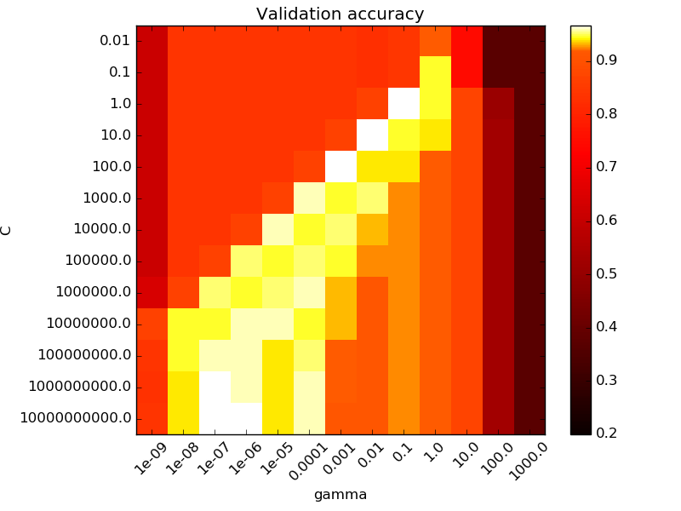
Grid Search
C parameter
gamma parameter
Source: http://scikit-learn.org/stable/auto_examples/svm/plot_rbf_parameters.html

Slide 65
Afternoon Session
1:30 PM - 5:30 PM
13 Cross-Validation
14 Model complexity and grid search for adjusting hyperparameters
15 Scikit-learn Pipelines
16 Supervised learning: Performance metrics for classification
17 Supervised learning: Linear Models
18 Supervised learning: Support Vector Machines
19 Supervised learning: Decision trees and random forests, ensemble methods
20 Supervised learning: Feature selection
21 Unsupervised learning: Hierarchical and density-based clustering algorithms
22 Unsupervised learning: Non-linear dimensionality reduction
23 Supervised learning: Out-of-core learning
A

Slide 66
Pipelines

Slide 67
Pipelines & Cross Validation

Slide 68
Afternoon Session
1:30 PM - 5:30 PM
13 Cross-Validation
14 Model complexity and grid search for adjusting hyperparameters
15 Scikit-learn Pipelines
16 Supervised learning: Performance metrics for classification
17 Supervised learning: Linear Models
18 Supervised learning: Support Vector Machines
19 Supervised learning: Decision trees and random forests, ensemble methods
20 Supervised learning: Feature selection
21 Unsupervised learning: Hierarchical and density-based clustering algorithms
22 Unsupervised learning: Non-linear dimensionality reduction
23 Supervised learning: Out-of-core learning
A

Slide 69
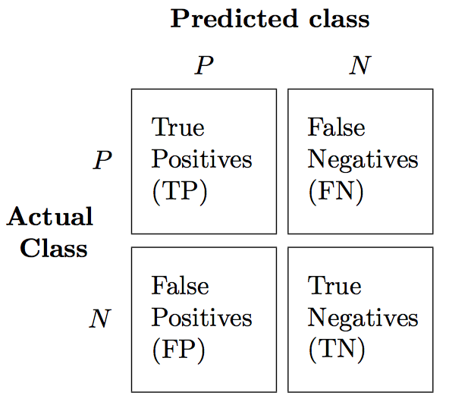
Confusion Matrix

Slide 70
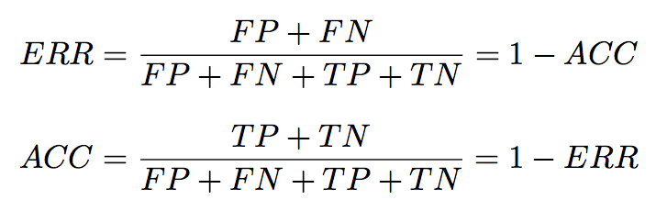
Classification Metrics I

Slide 71
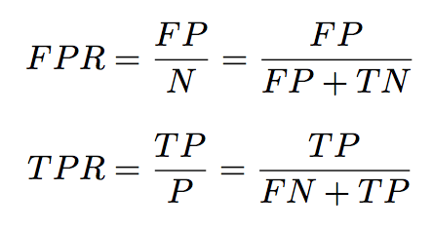
Classification Metrics II

Slide 72
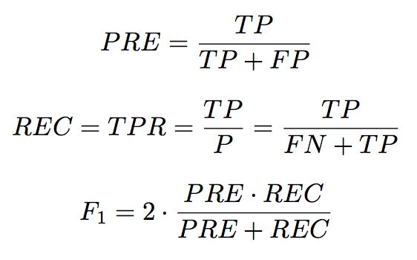
Classification Metrics III

Slide 73
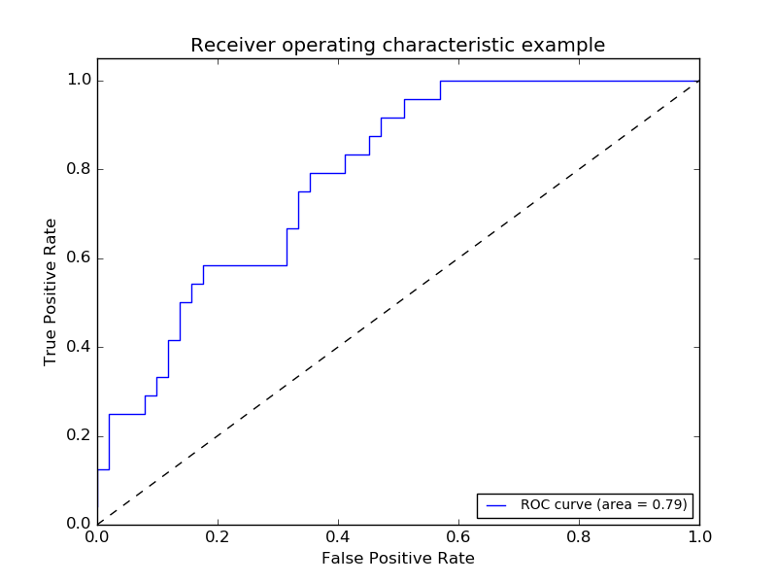
Receiver Operator Characteristic
Image source: http://scikit-learn.org/stable/_images/plot_roc_001.png

Slide 74
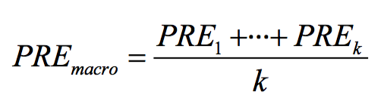
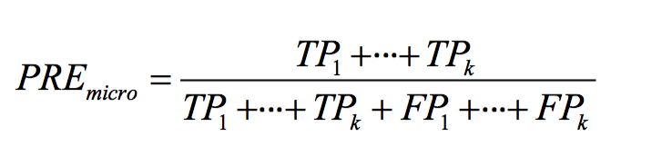
Multi-Class

Slide 75
Afternoon Session
1:30 PM - 5:30 PM
13 Cross-Validation
14 Model complexity and grid search for adjusting hyperparameters
15 Scikit-learn Pipelines
16 Supervised learning: Performance metrics for classification
17 Supervised learning: Linear Models
18 Supervised learning: Support Vector Machines
19 Supervised learning: Decision trees and random forests, ensemble methods
20 Supervised learning: Feature selection
21 Unsupervised learning: Hierarchical and density-based clustering algorithms
22 Unsupervised learning: Non-linear dimensionality reduction
23 Supervised learning: Out-of-core learning
A

Slide 76
Linear models for regression
y_pred = x_test[0] * coef_[0] + ...
+ x_test[n_features-1] * coef_[n_features-1]
+ intercept_
y
slope (=Δy/Δx)
x[0]

Slide 77
Afternoon Session
1:30 PM - 5:30 PM
13 Cross-Validation
14 Model complexity and grid search for adjusting hyperparameters
15 Scikit-learn Pipelines
16 Supervised learning: Performance metrics for classification
17 Supervised learning: Linear Models
18 Supervised learning: Support Vector Machines
19 Supervised learning: Decision trees and random forests, ensemble methods
20 Supervised learning: Feature selection
21 Unsupervised learning: Hierarchical and density-based clustering algorithms
22 Unsupervised learning: Non-linear dimensionality reduction
23 Supervised learning: Out-of-core learning
A

Slide 78
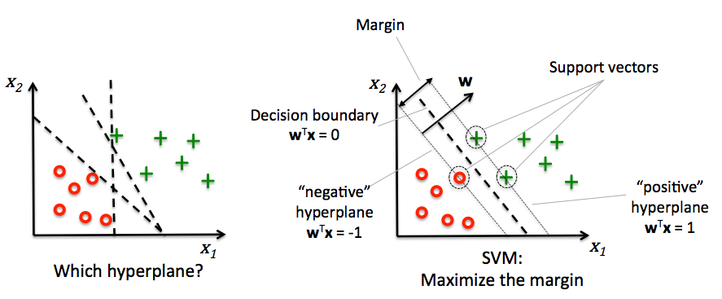
Support Vector Machines
Image source: https://github.com/rasbt/python-machine-learning-book/blob/master/code/ch03/images/03_07.png

Slide 79
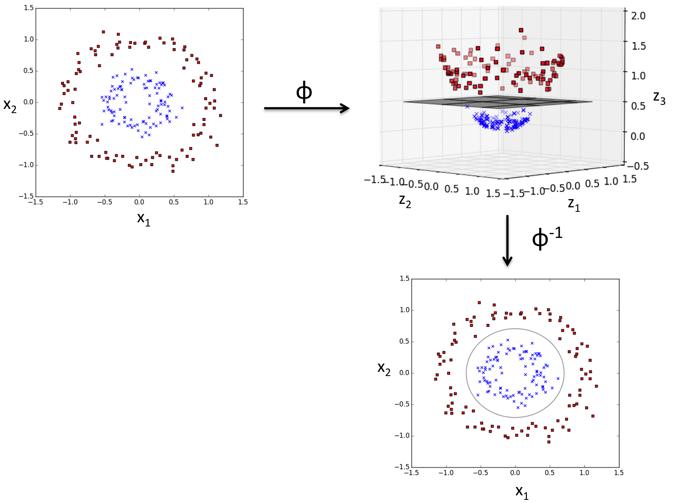
Kernel Trick
https://github.com/rasbt/python-machine-learning-book/blob/master/code/ch03/images/03_11.png

Slide 80
Afternoon Session
1:30 PM - 5:30 PM
13 Cross-Validation
14 Model complexity and grid search for adjusting hyperparameters
15 Scikit-learn Pipelines
16 Supervised learning: Performance metrics for classification
17 Supervised learning: Linear Models
18 Supervised learning: Support Vector Machines
19 Supervised learning: Decision trees and random forests, ensemble methods
20 Supervised learning: Feature selection
21 Unsupervised learning: Hierarchical and density-based clustering algorithms
22 Unsupervised learning: Non-linear dimensionality reduction
23 Supervised learning: Out-of-core learning
S

Slide 81
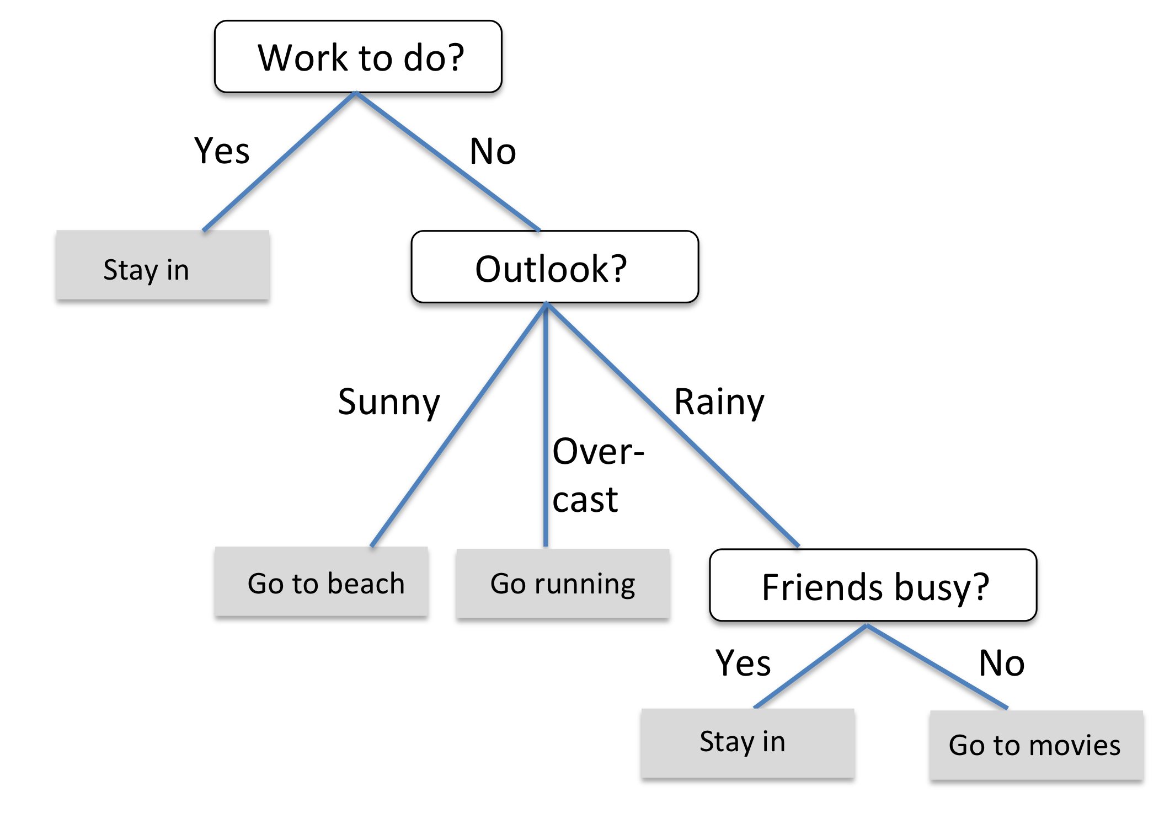
Decision Trees

Slide 82
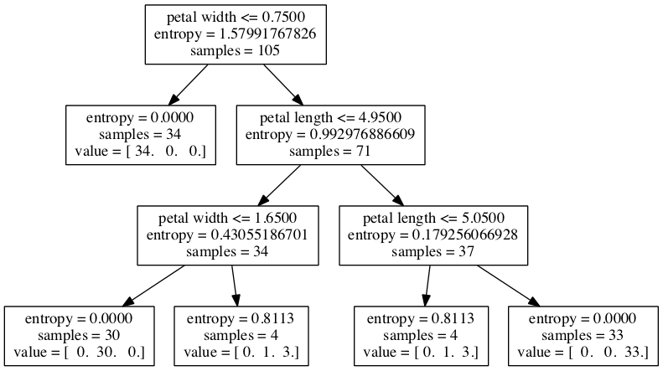
Classification w. Continuous Features

Slide 83
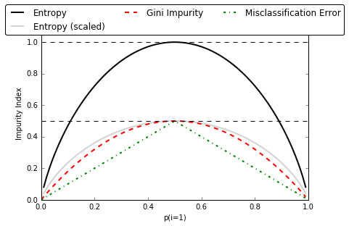
Impurity measures

Slide 84
Ensemble Methods
Bagging
Boosting
Random
Forests

Slide 85
Afternoon Session
1:30 PM - 5:30 PM
13 Cross-Validation
14 Model complexity and grid search for adjusting hyperparameters
15 Scikit-learn Pipelines
16 Supervised learning: Performance metrics for classification
17 Supervised learning: Linear Models
18 Supervised learning: Support Vector Machines
19 Supervised learning: Decision trees and random forests, ensemble methods
20 Supervised learning: Feature selection
21 Unsupervised learning: Hierarchical and density-based clustering algorithms
22 Unsupervised learning: Non-linear dimensionality reduction
23 Supervised learning: Out-of-core learning
S

Slide 86
Dimensionality Reduction
Dimensionality Reduction
Feature Selection
Feature Extraction

Slide 87
Afternoon Session
1:30 PM - 5:30 PM
13 Cross-Validation
14 Model complexity and grid search for adjusting hyperparameters
15 Scikit-learn Pipelines
16 Supervised learning: Performance metrics for classification
17 Supervised learning: Linear Models
18 Supervised learning: Support Vector Machines
19 Supervised learning: Decision trees and random forests, ensemble methods
20 Supervised learning: Feature selection
21 Unsupervised learning: Hierarchical and density-based clustering algorithms
22 Unsupervised learning: Non-linear dimensionality reduction
23 Supervised learning: Out-of-core learning
S

Slide 88
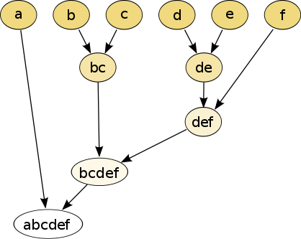
Hierarchical Clustering
https://en.wikipedia.org/wiki/Hierarchical_clustering#/media/File:Hierarchical_clustering_simple_diagram.svg [CC BY-SA 3.0]

Slide 89
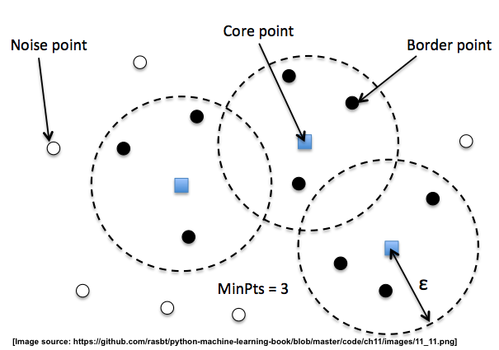
DBSCAN

Slide 90
Afternoon Session
1:30 PM - 5:30 PM
13 Cross-Validation
14 Model complexity and grid search for adjusting hyperparameters
15 Scikit-learn Pipelines
16 Supervised learning: Performance metrics for classification
17 Supervised learning: Linear Models
18 Supervised learning: Support Vector Machines
19 Supervised learning: Decision trees and random forests, ensemble methods
20 Supervised learning: Feature selection
21 Unsupervised learning: Hierarchical and density-based clustering algorithms
22 Unsupervised learning: Non-linear dimensionality reduction
23 Supervised learning: Out-of-core learning
S

Slide 91
PCA
2D
1D
?

Slide 92
PCA
2D
1D

Slide 93
Kernel PCA
2D
1D

Slide 94
Afternoon Session
1:30 PM - 5:30 PM
13 Cross-Validation
14 Model complexity and grid search for adjusting hyperparameters
15 Scikit-learn Pipelines
16 Supervised learning: Performance metrics for classification
17 Supervised learning: Linear Models
18 Supervised learning: Support Vector Machines
19 Supervised learning: Decision trees and random forests, ensemble methods
20 Supervised learning: Feature selection
21 Unsupervised learning: Hierarchical and density-based clustering algorithms
22 Unsupervised learning: Non-linear dimensionality reduction
23 Supervised learning: Out-of-core learning
S

